Slide 1
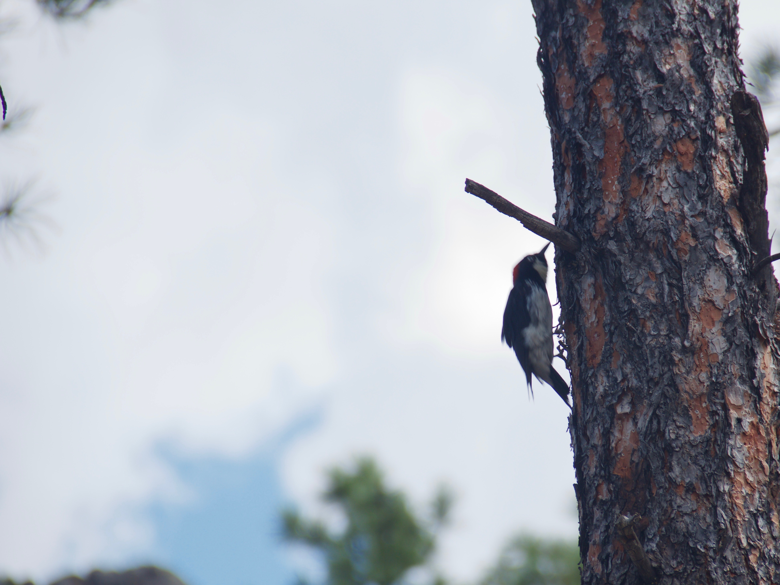
A problem; a solution:
Press. No complications; fast, easy.
No downloads, just birds.
Similarities; for identification on the fly.
Tools, and we don’t mean binoculars.
Trello – To keep our ducks in a row.
Bootstrap – To build our nest.
Apache HTTP Server – Seen around the world.
Digital Ocean – Because the sky isn’t always blue.
PHP – So you can extend a branch and ask a question.
MySQL – To put the eggs in our nest

Slide 2
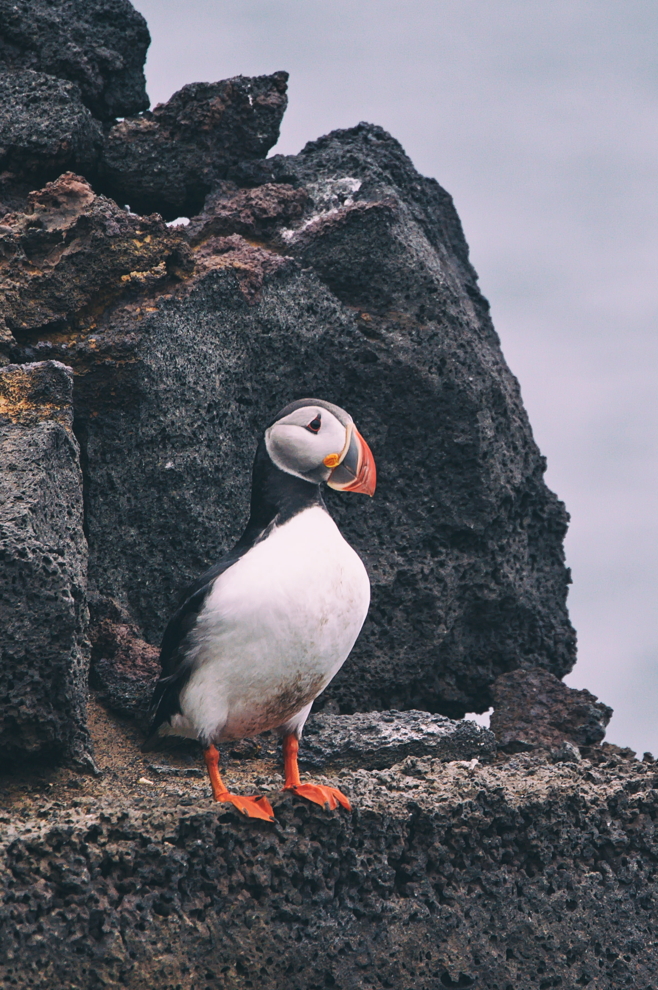
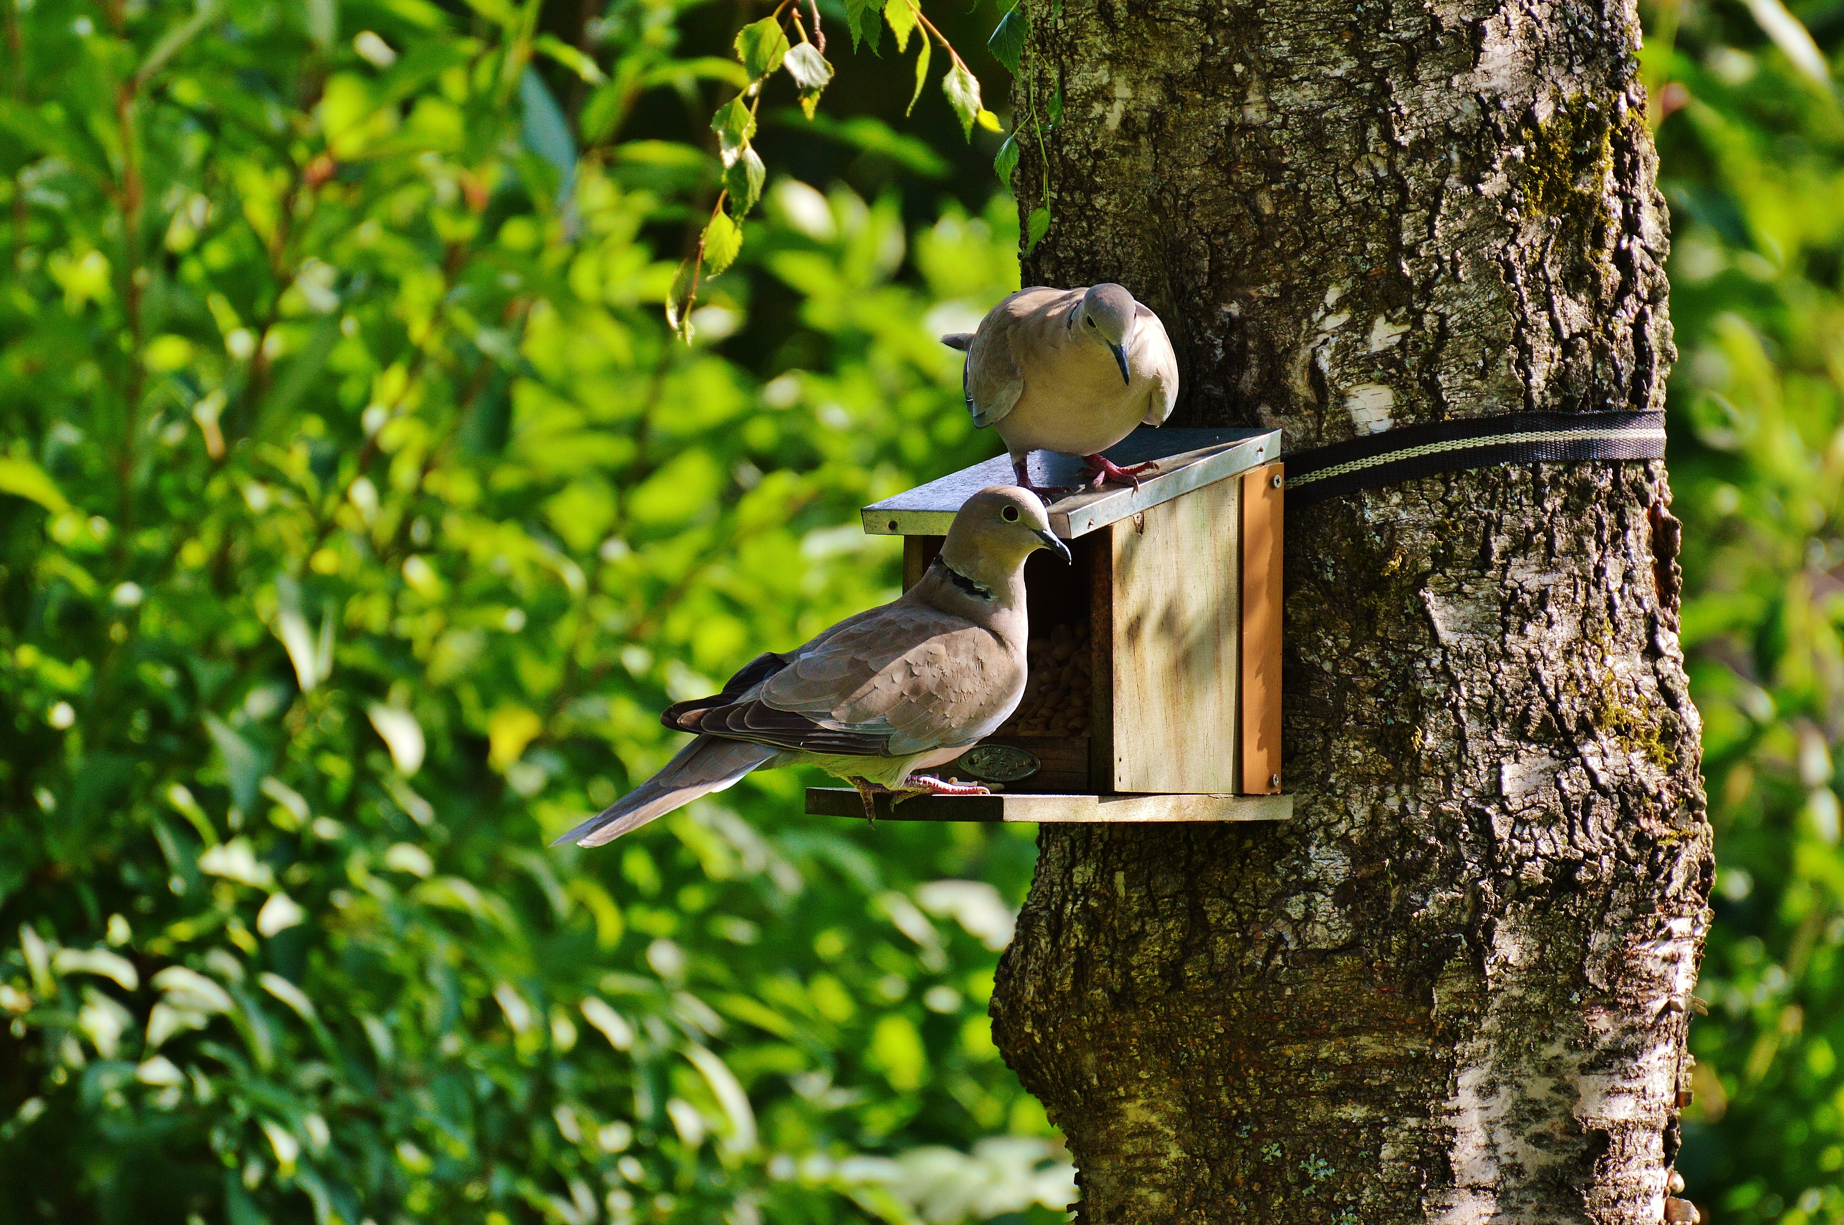
Behind the Website
Behind the Database
LANDING PAGE | GITHUB PAGES
MYSQL
ABOUT US
FILTER OPTIONS
SUBMISSIONS
SIZE SELECTION
DISPLAY PAGE
COLOR SELECTION
NOTABLE FEATURES
BOOTSTRAP
PHP
HTML
APACHE HTTP SERVER
CSS

Slide 3
